Slide 1
Imperva Data Security
Prashanth Manchaiah
Notes:
This deck covers Imperva Data Security and is intended to be customer-facing. In this deck, we provide an overview of key customer challenges/problems the Imperva Data Security solution addresses and how we at Imperva protect the pulse of our customers’ businesses.

Slide 2

Agenda
Imperva Database Security Solution Overview
(a) Database Security Features
(b) Deployment methods
Imperva Database Security Workshop
(a) Discovery and Classifying [(i) Servers, (ii) Classified DB Data & (iii) DB User Rights Management]
(b) Site Tree
(c) Protected IP’s and Service Ports
(d) Active, Simulation and Disabled Modes
(e) Profile Overview
(f) Security and Audit Policy Overview
(g) Audit Dashboard Overview
(h) Risk Management
(i) Real Time Dashboard Overview
Pre Requisites Workshop
(a) Referring to HLD Document
Project Plan
(a) Referring to Project Plan Document
Next Action

Slide 3






Imperva’s mission is to provide a complete solution
Web Application Firewall
Database Security
File Security
Tech. Attack
Protection
Usage
Audit
Logic Attack
Protection
User Rights
Management
Fraud
Prevention
Access
Control
External
Customers
Staff, Partners
Hackers
Internal
Employees
Malicious Insiders
Compromised Insiders
Vulnerability
Scanning
Discovery &
Classification
Virtual
Patching
Privileged User
Activity Audit
Data Center
Systems and Admins

Slide 4





Imperva Database Security Features
Counter Breach /Data Risk Analytics
Counter Breach provides the ability to learn typical user access to data and then detect inappropriate or abuse activity.
Database Firewall
Activity Monitoring and real-time protection for critical databases
Database Activity Monitoring
Full auditing and visibility into database activities
User Rights Management
Review and manage user access rights to sensitive data
Discovery & Assessment Server
Vulnerability assessment, configuration management, database discovery and classification
ADC Insights
Pre-packaged reports and rules for SAP, OracleEBS and Peoplesoft compliance and security
Notes:
[CLICK]
Database Firewall, Database Activity Monitoring and Discovery and Assessment server make up our core [CLICK] products.
Database Firewall or DBF Provides real-time database protection against internal and external threats by alerting or blocking attacks and abnormal access requests. SecureSphere Database also works with our Discovery & Assessment Server to virtually patch database software vulnerabilities reducing the window of exposure and impact of long patch cycles. Finally DBF includes all of the auditing and analytics capabilities offered by DAM which I’ll discuss next.
Database Activity Monitoring or DAM Delivers automated scalable activity monitoring, auditing, and reporting for heterogeneous database environments. SecureSphere DAM helps organizations demonstrate regulatory compliance through automated processes, analysis, and reporting. This product also accelerates incident response and forensic investigation with centralized management and advanced analytics.
Discovery and Assessment Server or DAS Provides vulnerability assessment and configuration audits allowing users to measure compliance with industry standards and best practices. Data discovery and classification enable organizations to accurately scope security and compliance projects. With a combined analysis of sensitive data and vulnerabilities, SecureSphere helps prioritize and better manage risk mitigation efforts. It’s worth noting here that both DBF and DAM include the Discovery and Assessment Server functionality.
User Rights Management for Databases or URMD is an add on product that enables automatic aggregation and review of user access rights. URMD helps identify excessive rights and dormant users based on organizational context and actual data usage. Using URMD, organizations can demonstrate compliance with regulations such as SOX, PCI 7, and PCI 8.5 and reduce the risk of a data breach.
ADC Insights is an add on product that provides pre-packaged audit policies, security policies and reports for leading enterprise applications. This streamlines compliance and security projects for key regulations such as SOX, PCI DSS, HIPAA, and others. Insights packages are available for SAP, Oracle EBS (E-Business Suite), and PeopleSoft.
[CLICK]

Slide 5











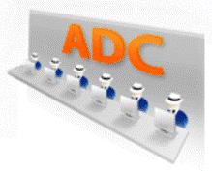
Imperva Architecture & Deployment Options
DBA/Sys admin
Agent Auditing
Data Center Enterprise Databases
Database Activity Monitoring
Network Auditing
Network Auditing
Users
Agent Auditing
Database
Firewall
Management
Server (MX)
DBA/Sys admin
Notes:
[CLICK] Here are all of your databases residing in your data center
[CLICK] Most of your users are accessing the database via applications connected to the network
[CLICK] And, in many cases your DBA’s and System Administrators are accessing the databases locally
[CLICK] Here we have both the DAM and DBF products deployed on the network. The products run on hardened appliances which deliver superior performance and scalability for demanding network environments. They offer Fail open interfaces and are Fault Tolerant
[CLICK] And you can choose between a physical or virtual appliance deployment to align with your data center virtualization strategy.
In this illustration, the DAM appliance is deployed in a Non-inline Deployment or in Sniffing mode, which is used primary for auditing database activity with zero network latency. The DBF appliance is deployed as a Transparent Inline Bridge which sees all database traffic to support blocking with high performance and low latency. It is also worth noting that the appliance offers fail-open interfaces to ensure uptime.
[CLICK] Monitoring the activity of the DBA’s and System Administrators and anyone with local access to the database is done using an agent which is installed on the database server.
[CLICK] All of the audit data is stored on the appliances in indexed files and the management server interface manages this data using the indexes. If more storage is required and SAN can be mounted to the server.
[CLICK] Finally, to ensure that your SecureSphere deployment is always armed with the latest defenses against new threats, and the most recent regulatory compliance best practices, updates to policies, reports and software are automatically sent to your system by Imperva’s research group – the Application Defense Center. The ADC is our team of experts that research the latest attack vectors and vulnerabilities .
[CLICK]

Slide 6
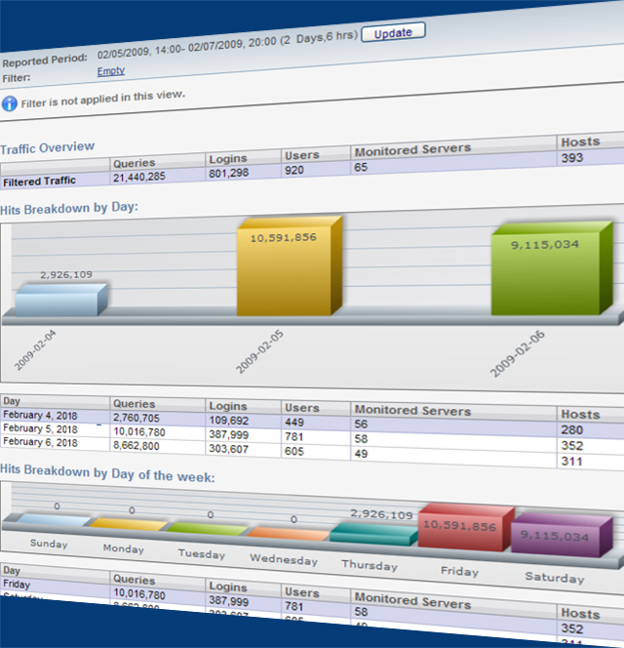
Data Activity Monitoring
Continuously monitor interactions with data.
Benefits
Provides visibility into who is accessing what data and when
Protects authorized data access, including privileged users and service accounts
Streamlines compliance with data privacy and protection regulations
Key capabilities
Pre-defined policies and simple configuration of custom policies
Consistent policy and standardized reporting across diverse data environments
Detects data access anomalies and create real-time alerts
Notes:
Once sensitive data has been identified, you can then monitor how users and applications interact with the data. Imperva Data Security provides continuous monitoring with separation of duties. It captures and analyzes all database activity from both application and privileged user accounts, providing detailed audit trails that show who accesses what data, when, and what was done to the data. The robust security rules engine enables organizations to customize security policies, and provides real-time alerting or blocking for policy violations.
Imperva Data Security enforces a unified security and compliance policy across heterogeneous data environments. It standardizes log events across various platforms, providing a consistent view over relational databases, mainframes, big data platforms, and data warehouses. It also supports databases in Microsoft Azure and Amazon Web Services (AWS) - including PaaS offerings such as Azure SQL and Amazon Relational Database Services (RDS). Detailed data activity is captured automatically, making it so much easier to fulfill audit requests.

Slide 7
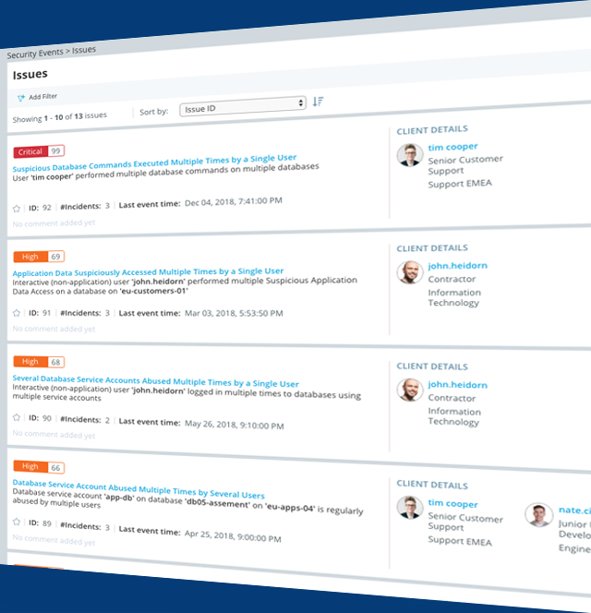
Data Risk Analytics
Detect the real threats to your data.
Benefits
Distills millions of alerts to a handful high-risk incidents
Reduces volume of data sent to SIEM
Prioritizes data threats for investigation
Key capabilities
Creates a contextual baseline with user and data profiling
Detects specific abusive and risky data activity with pre-configured algorithms
Scores issues by risk level
Notes:
After collecting granular details and events captured by data activity monitoring, we then run data risk analytics on top of them. Imperva Data Security helps detect the real threats to your data, utilizing machine-learning, data access and user behavior analytics to distill millions of alerts and pinpoint critical incidents. As a result, only a few high-risk incidents are surfaced and far fewer incidents get sent to a SIEM. It also improves efficiency and effectiveness of your security team because they no longer have to filter out the noise and try to make sense out of all the security alerts that bombard them. Imperva accelerates incident detection and helps you find a needle in a haystack.
QUESTIONS TO ASK YOUR CUSTOMERS:
How many security events does your company generate per day?
Are you using a SIEM to manage all these alerts?
Is your security team able to handle them?

Slide 8
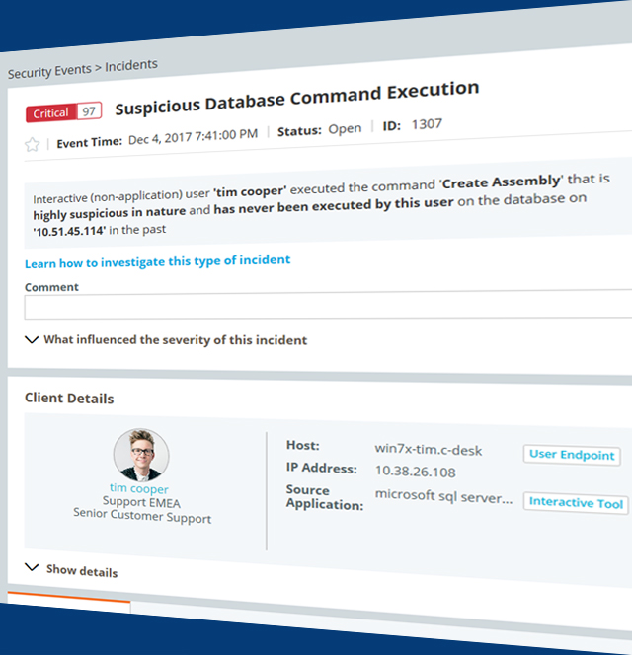
Protect and Respond
Stop risky or suspicious activity.
Benefits
Contain data breaches
Prevent unauthorized data access
Streamline incident investigation
Key capabilities
Defines policies to alert, block, quarantine, report on inappropriate data activity
Explains incidents in plain language that security teams understand
Masks sensitive data with fictional but realistic data
Notes:
We prioritize incidents using scoring and grouping capabilities to allow your security team to focus on what matters most and provide actionable insights. Imperva data security also accelerates incident investigation and response by interpreting security incident in plain language, so your security team can quickly obtain visibility into what’s happening in the data environment and can carry out a successful investigation without the need to have deep database knowledge. In addition, it enables incident responders to block or quarantine suspicious users and block any unauthorized or inappropriate data access. You can also customize whitelisting and blacklisting policies to alert, block, or report on any unacceptable data access.
For non-production environment, such as QA, testing, or app development, Imperva data security also provides data masking capabilities to reduce attack surface. It replaces sensitive data with fictional but realistic data, maintaining data utility without exposing critical information.

Slide 9
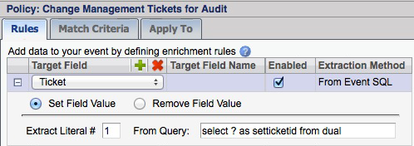
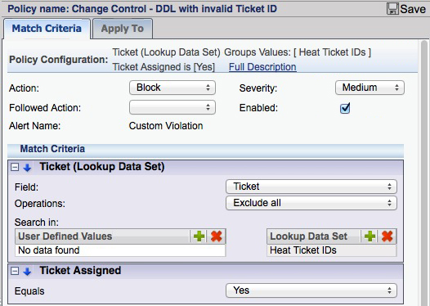
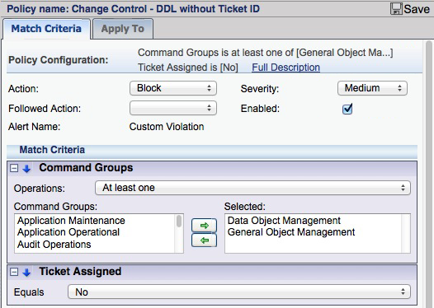
Identify and Block Unauthorized Transactions
Notes:
• 404 - The company’s external auditor must report on the reliability of management's assessment of internal control

Slide 10
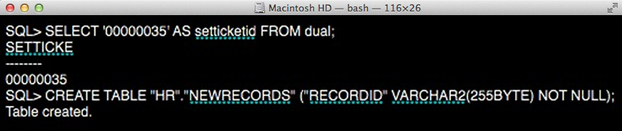
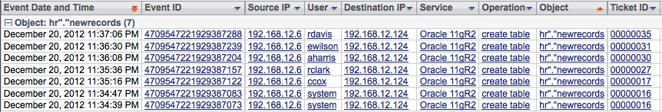
Change Control Reconciliation

Slide 11
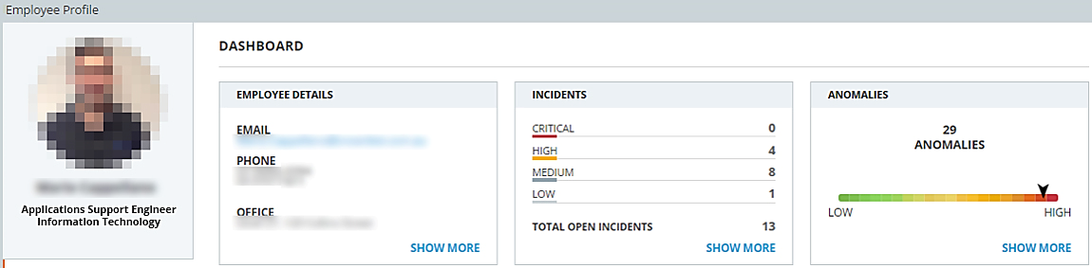
Suspicious Application Data Access
John Smith is an Applications Support Engineer per his Active Directory record.
A number of Incidents were detected around John’s interaction with company data.
Here we focused on one of these that stood out.
25
Notes:
Background & Talking point
Permissions to access business data are granted and managed through the application. The application therefore enforces access data on a need-to-know basis. At the same time, individuals in the organization - such as DBAs and developers - are tasked with maintaining the integrity and operation of the system and data. For this reason, they are granted almost full access to the data. These individuals expose the enterprise to risk because:
1. Their credentials are desirable targets for hackers.
2. They can make mistakes that expose and duplicate sensitive application data, moving it outside the purview of IT control.
3. In the event there is malicious intent, these individuals have a carte blanche to access to all data.
These individuals, however, should not access sensitive business data as part of their jobs (except in rare emergencies). Access to application data – as opposed to metadata – may be an indication of potential compromise, malice or negligence.
This also violates compliance best practices.

Slide 12


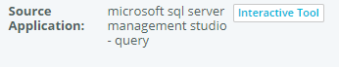
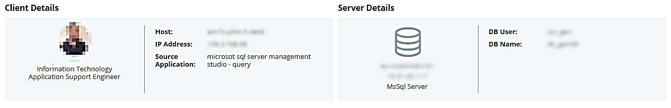
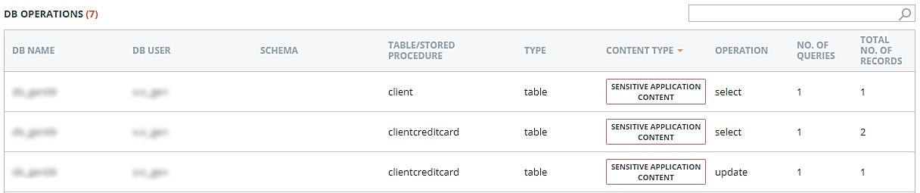
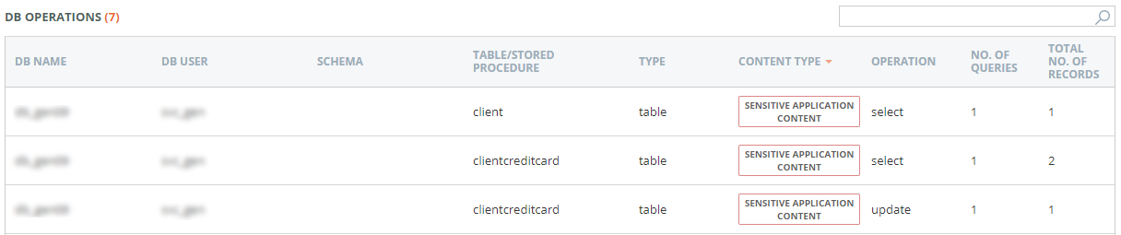
INCIDENT DESCRIPTION
John was identified as directly accessing business data (cc info) that should normally only be accessed via an application.
26
Notes:
Background & Talking point
Permissions to access business data are granted and managed through the application. The application therefore enforces access data on a need-to-know basis. At the same time, individuals in the organization - such as DBAs and developers - are tasked with maintaining the integrity and operation of the system and data. For this reason, they are granted almost full access to the data. These individuals expose the enterprise to risk because:
1. Their credentials are desirable targets for hackers.
2. They can make mistakes that expose and duplicate sensitive application data, moving it outside the purview of IT control.
3. In the event there is malicious intent, these individuals have a carte blanche to access to all data.
These individuals, however, should not access sensitive business data as part of their jobs (except in rare emergencies). Access to application data – as opposed to metadata – may be an indication of potential compromise, malice or negligence.
This also violates compliance best practices.

Slide 13
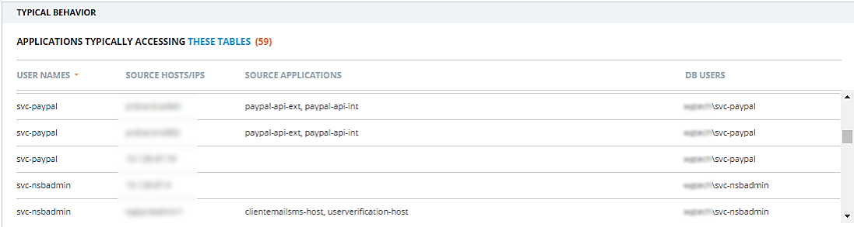
Suspicious Application Data Access
A number of service accounts (applications) are typically used to access this data. CounterBreach flagged a human touching this data.
27
Notes:
Background & Talking point
Permissions to access business data are granted and managed through the application. The application therefore enforces access data on a need-to-know basis. At the same time, individuals in the organization - such as DBAs and developers - are tasked with maintaining the integrity and operation of the system and data. For this reason, they are granted almost full access to the data. These individuals expose the enterprise to risk because:
1. Their credentials are desirable targets for hackers.
2. They can make mistakes that expose and duplicate sensitive application data, moving it outside the purview of IT control.
3. In the event there is malicious intent, these individuals have a carte blanche to access to all data.
These individuals, however, should not access sensitive business data as part of their jobs (except in rare emergencies). Access to application data – as opposed to metadata – may be an indication of potential compromise, malice or negligence.
This also violates compliance best practices.

Slide 14
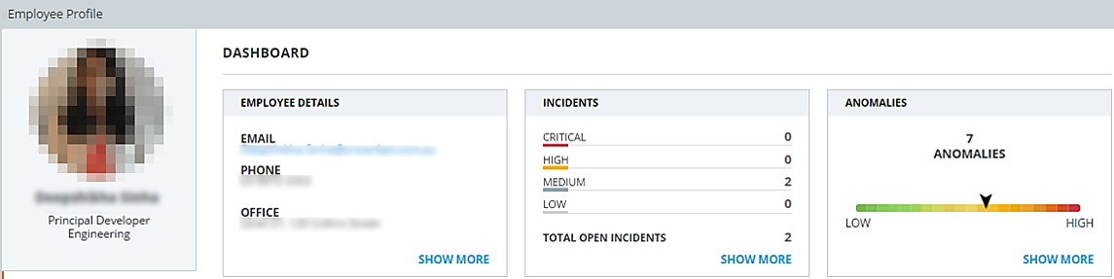
Suspicious Application Data Access
Laura Smith is a Principal Developer and a member of the Engineering Group per her Active Directory record.
Laura should only be working within the database Dev environment and with non-production databases and data-sets.
25
Notes:
HealthCare

Slide 15
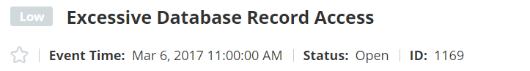
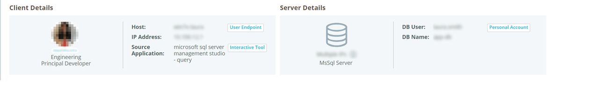

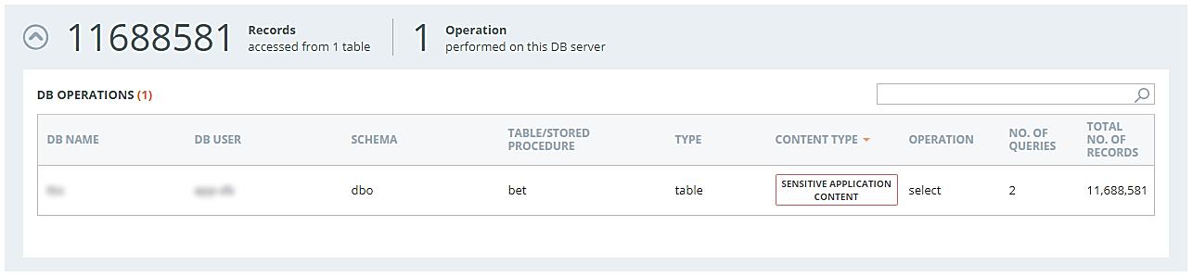
INCIDENT DESCRIPTION
Laura retrieves an excess of 11.6 million records using ‘microsoft sql server management studio’ from a production database which is abnormally high. Usually two specific applications would access these records directly.
31
Notes:
Background & Talking point

Slide 16
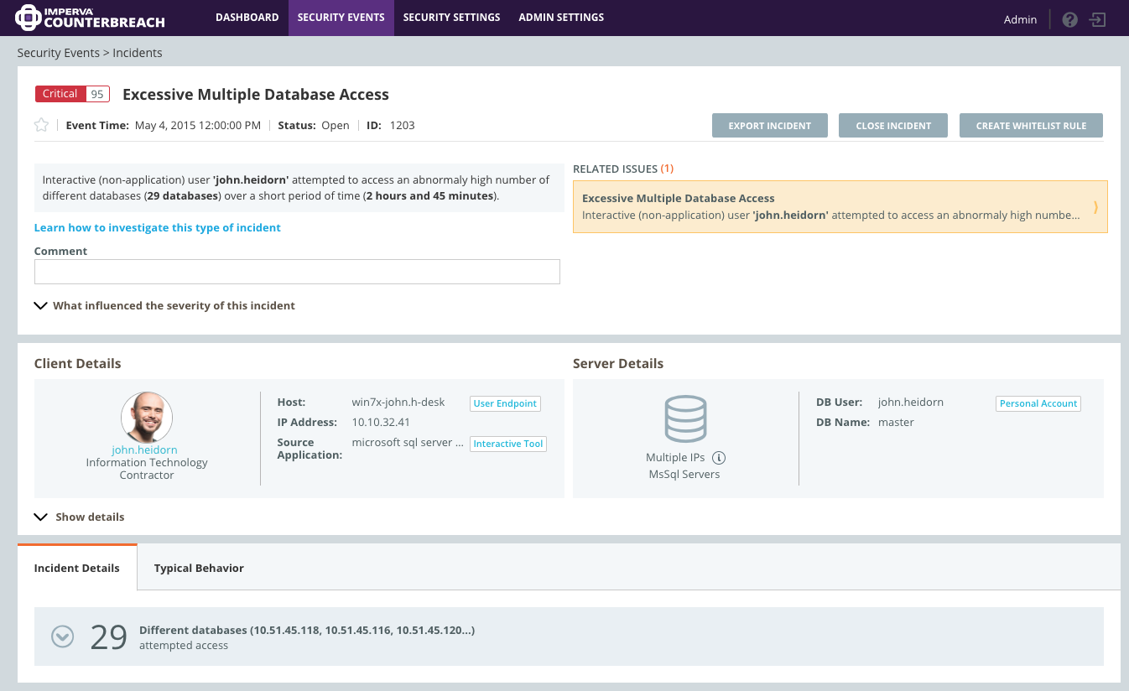
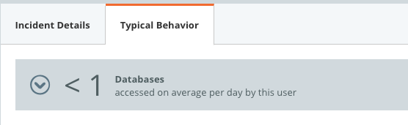
Example of a Database Incident
The user attempted to access 29 different DBs over a short period of time.
Prioritize what matters the most.
Interpret security incident in plain language.
Notes:
Here’s an example of a database incident created by Imperva CounterBreach:
(Click) An incident called “Excessive Multiple Database Access” was created and prioritized as critical.
(Click) There’s a short description that summarizes what happened in the database environment and why it is suspicious.
(Click) It then tells you client details- Which user is accessing what data, and how the data is being used.
(Click) If you look at incident details, it tells you that this user, John Heidorn, has attempted to access 29 different databases within a short period of time.
(Click) And the reason why it is suspicious was because John typically accessed less than 1 database per day.

Slide 17
Thank You
Prashanth Manchaiah

